Slide 1

FeatureCAM 3d in V2007
Notes:
What’s diff? What’s missing from v12?

Slide 2
3D
Uses Delcam UK technology.
Major new functionality: remachining, undercuts, tapered tools, 4-axis rotary
Minor changes: User Interface, tweaks to existing opers
Notes:
Most of the toolpaths are computed by a library from Delcam UK. (All but plunge rough)
**So, today, we’re going to go over some of the brand new technology.
**I’ll also point out some UI changes, and some new attributes on “old operation-types”.

Slide 3
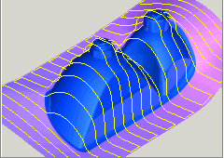
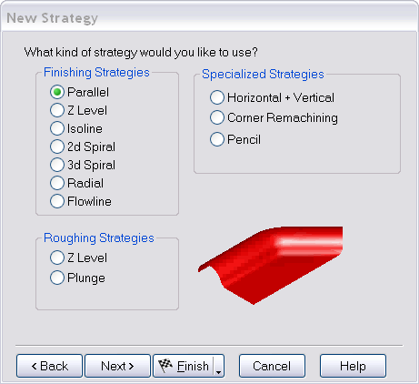
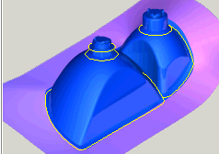
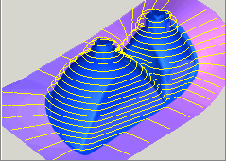
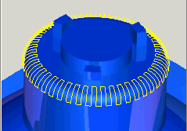
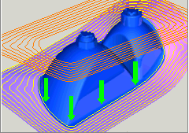
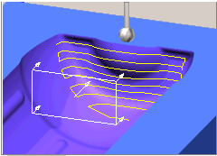
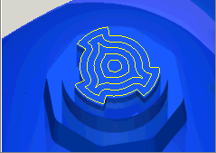
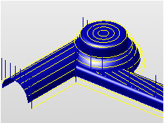
User Interface
Notes:
New feature new strategy
The ‘3d new strategy’ page has the most obvious changes. We have grouped the strategy choices by finishing, roughing, and “special” strategies.
We’ve also revamped the help pages. all these pictures came out of the help file. There’s more of an overview section and “why you’d want to use a particular strategy” section.

Slide 4
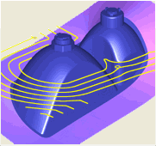
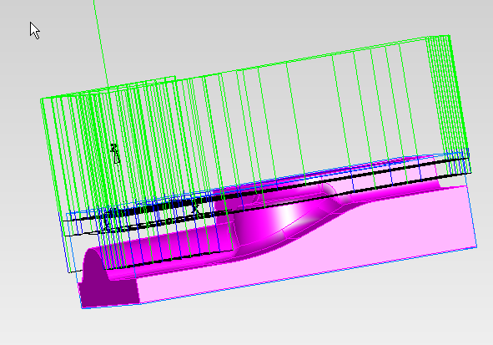
Z level roughing
New option to raster rough the slice (like parallel roughing).
Reorder does depth-first.
New options for HSM.
Flat surface – area only.
Multiple diameter (Z-semi) works well.
Notes:
Z-level - bring up empty_start.fm show raster option on strategy page. Play-to-next Z level several times. Flip back to PPT before it does the reorder/depth first.
Introduce HSM one at a time.
Start with corner radius %
Toolpath corner%
Stepover arc
Trochoidal cut
DONE WITH HSM FLIP BACK TO PPT
Bring up zrough_flat.fm

Slide 5
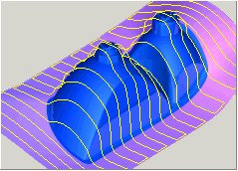
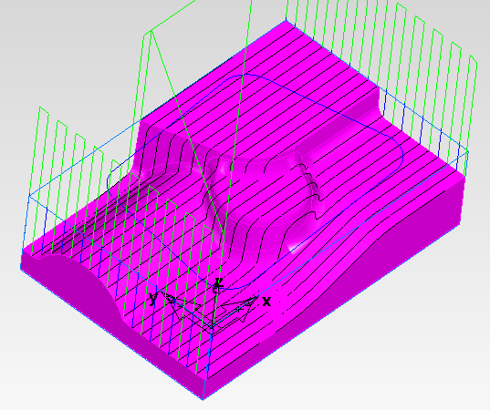
Parallel finishing
New option to automatically add perpendicular remachining pass.
Notes:
Parallel finishing is mostly the same. There is a new checkbox to auto add a remachining pass (which uses the same tool, f/s, machining attributes, etc.)

Slide 6
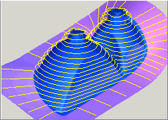
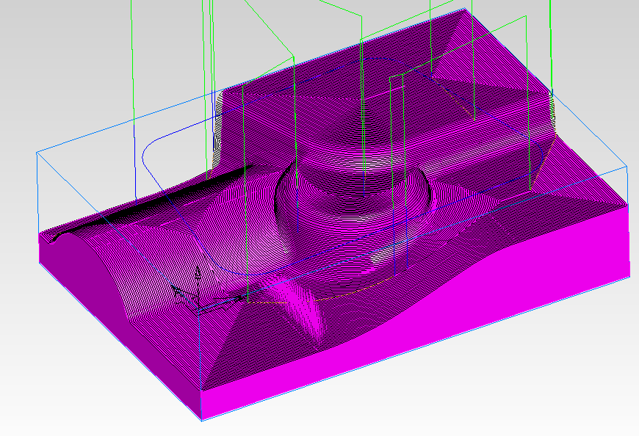
Z level finishing
New option to “spiral” instead of “step-down”.
Corner correction – inserts an arc at internal corners.
Notes:
Z finishing is mostly the same. There is a new checkbox to spiral down instead of stepping.

Slide 7
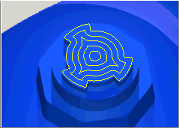
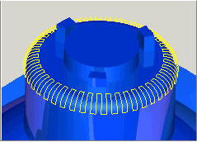
Other types of finishing
Spiral, as well as isoline, is identical to v2006 except that spiral is called “2d spiral”.
Some new attributes for radial (e.g., start/end angle, stepover angle)

Slide 8
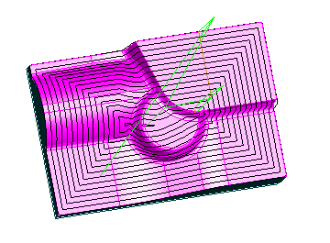
Spiral 3d finishing
A new operation type, Spiral3d, steps over “in 3d”.
Spiral remachining
Notes:
***3D 3D spiral is a type of stepover. Not really scallop height, but same effect. Steep surfaces get a nice stepover.
***Spiral Remachining it can now handle steep and shallow regions. We couldn’t do that before.***

Slide 9
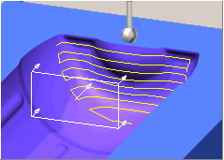
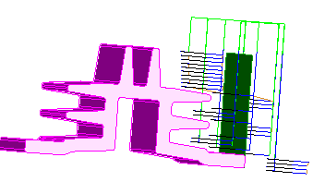
Flowline finishing
Another new operation type similar to isoline. Projects the isolines from one surface onto the surfaces of the feature. The isolines are projected in the direction of the surface normal.
Undercutting technique

Slide 10
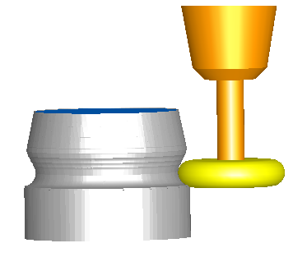
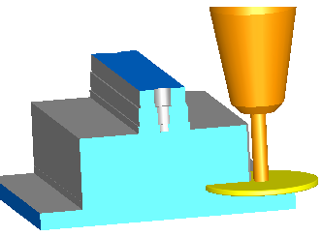
Flowline finishing
Use a side mill cutter (only available in operations supporting undercuts - Isoline and flowline)
Support for lollipop endmills
Visit leads page!
Stepover rapid distance
Notes:
Select an appropriate side mill cutter. FeatureCAM will not automatically select side mill cutters.
Specify a Horizontal lead-in/out plane on the leads tab. You may also have to experiment to determine an appropriate Ramp diameter to prevent gouging

Slide 11
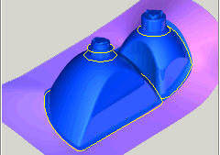
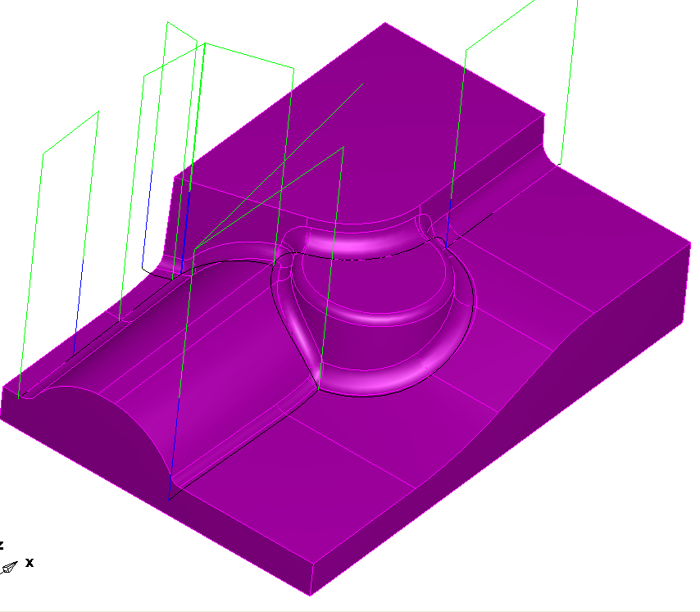
Specialized strategies - Pencil
What’s new with pencil?
  Slope restrictions
  Supports bull-nose, flat-end tools
  Remachining (multi-pass pencil)
  Just works (no remachining page)

Slide 12
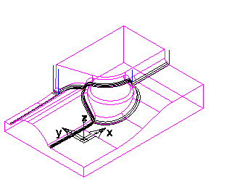
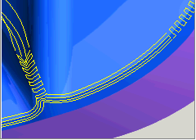
Specialized strategies - Corner
New strategy similar to multi-pass pencil.
Remachining (only).
Along – cuts the “non-arc direction” of the fillet
Across – cuts the arc of the “fillet”
Combo – Across steep areas, and along shallow
Notes:
Corner remachining is used to clean up corners that occur between non-tangential surfaces. Each "corner edge" is called a "trace line". By using the options on the strategy page, you may cut in various directions relative to the trace lines.
Corner remachining is available in four different styles: along, across, combo along and across and Multi pencil.
Along
This style of remachining creates a corner toolpath which will follow the trace lines.
Across
Across remachining creates corner toolpaths that zig-zag across the trace lines.
Combo Along and Across
The combo corner toolpath creates a corner toolpath which produces Across toolpaths on the steep areas of the trace line and Along toolpaths on the shallow areas of the trace line.
Multi-pencil
Creates a corner toolpath which will follow 'along' the trace lines. This is basically a different ordering of the 'along' tool path.
Note that the slope boundaries tab is available, so that a "horizontal-only" corner operation is possible.
Detection Limit - only corners below the angle specified will be found.

Slide 13
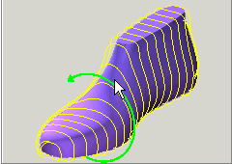
Specialized strategies - Rotary
New strategy
Rotary milling creates toolpaths that cut surfaces without the need for wrapping.
Three options: circular, linear or spiral
Notes:
Rotary – only avail in 4-axis indexed parts parts. (turnmill too)

Slide 14
What’s missing from v2006?
Roughing – No parallel, spiral, isoline roughing. (Z level or plunge now).
Parallel finishing doesn’t have the scallop height option.
Plunge points and Start points: Probably will be supported by toolpath editing in future versions.
Z level "bottom_up“ (finish or rough)
Z rough with: "open pocket", "auto" (boss or pocket)
Pre-drill: Independent pre-drill operation not supported. (Pre-drill locations are calculated as part of rough now).
Spiral: uphill/downhill only, start_pts
First feed - Number of first feed paths
Improved
Preview slices in Z rough and Z finish
Notes:
Rough: z rough with raster option to address parallel roughing. Spiral is similar enough to Zlevel?
No scallop height on some opers: Notably: parallel. Z finish, spiral3D, isoline, and remachining operations support scallop height
Bottom-up: Would like to support, might be in future versions. This is an old request from a Bridgeport AE A-006396
Open pocket: V13 "boss" with an appropriate stock curve produces fairly similar results .. "auto": An educated guess in V12 which didn't get it right a lot of the time.
Pre-drill: Only if accompanied by a Z rough. Most V12 uses of pre-drill should be with a rough of some sort. (Pre-drill locations are auto calculated)
Spiral : Uphill/downhill: Could support for spiral2D if requested. Start_pts: See Z finish.
1st feed : Would prefer methods that duplicate the toolpaths horizontally or vertically as a way to step into the material for the first cut of a region. These V12 attributes were our workaround for that, but they are not supported in V13. See A-012620.
Improved : numerical “improvement” only really worked in limited situations.
Preview slices : was useful in the past because of robustness concerns that should no longer be necessary.

Slide 15
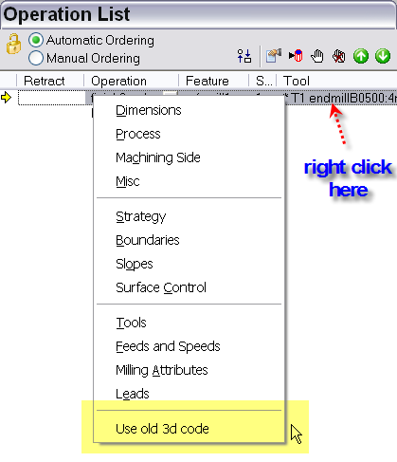
What’s missing? (continued)
Back door to V12
Notes:
Right click on oper in the operation list: will flag it as use v12 UI and code. We don’t plan on supporting it forever.

Slide 16
What’s good about it?
New remachining/better pencil milling – along and/or across options, multi-pencil.
4 axis simultaneous - Z or X parallel, continuous spiral?
3D offset (spiral).
Tapered tool support
Full tool support for remachining and pencil milling.
Flowline/Isoline support undercuts.
Other selling points
Increased performance
Improved Z roughing (better flat surface support, reordering, HSM options)
Improved Z semi-finishing
Improved lead-in and HSM capabilities
More robust
Notes:
Performance-wise:
Large speed up for basic parallel and spiral finishing in almost all cases.. Large speed up for pencil milling in many cases, some simple cases are comparable or slower in V13. Large speed up for combination remachining and remachining on complex parts. V12 remachining is fairly limited so, it's hard to compare many of the new options for V13. Z finish and Z rough are equal to or slower than V12. Slower cases tend to be 150% - 200% of the time.

